Slide 1

Excellent Coaching
C2005L - Group 1
Truong Vu Binh
Dao Ngoc Quan
Dinh Sy Quang
Tran Minh Tuan
Instructor: Dang Tran Long

Slide 2


Index
Problem Definition
Customer Requirements Specification
System Design

Slide 3

Problem Definition
Problem Abstraction
The Current System
The Proposed System
Boundaries of the System
System Requirements

Slide 4
Problem Definition
1. Problem Abstraction
Technologies are developing as well as the society, as such a new means of services: Online services
Website has gradually becoming a more efficient way of introducing and advertising for educational centre
Excellent Coaching is a course introductory website of a technology training centre of the same name, that aims to helps the centre reaching a wider range of audience

Slide 5
Problem Definition
2. The current System
Information is not fully up-to-date with the changes of the centre
Costly Marketing fee when advertising in traditional means
Difficulty in answering queries from students
Mistakes can happens on telephone marketing
Notes:
Khó khăn trong việc hỗ trợ, giải đáp thắc mắc từ phía học viên/khách hàng

Slide 6
Problem Definition
3. The Proposed System
Provides students with latest information about currently offering courses
Student can register a course of their choice directly on website, as well as able to send a message to the centre
Introduce centre’ faculty, their achievements, as well as their career

Slide 7
Problem Definition
4. Boundaries of the System
Information sent on the Internet is not secured, as such, personal data can be leaked. Customer are to be worried about their personal information being revealed.
False information about the centre can be posted online without verification, leading to negative impression about the centre.
Most of the limitation came from the fact that online services are still brand-new, it cannot replace traditional method. Furthermore, private institution is different from public one, as such, customer may not fully believe in the provided information on the websites

Slide 8
Problem Definition
5. Systems Requirements
Minimum Requirements
Recommended Requirements
 | Server | Client
Hardware | RAM: 2GB or more CPU: 2.00 GHz Xeon or more 40 GB of HDD free space or more Internet access and LAN | RAM: 1GB or more CPU: 1.50 GHz or more Internet Access At least 20GB of HDD free space or more
Software | Windows Server 2008 or Linux MySQL, PHP IIS/Apache with Sendmail add-on | Windows 7 or later Latest version of IE, Edge, Chrome, Firefox, Safari
 | Server | Client
Hardware | RAM: 4GB or more CPU: 2.4 GHz Xeon or more 80 GB of HDD free space or more Internet access and LAN | RAM: 2GB or more CPU: 2.00 GHz or more Internet Access At least 40GB of HDD free space or more
Software | Windows Server 2016 or Linux MySQL, PHP IIS/Apache with Sendmail add-on Having port 8888, 3306 opened | Windows 7 or later Latest version of IE, Edge, Chrome, Firefox, Safari

Slide 9
Customer Requirement Specifications
User of the System
System functions

Slide 10
Customer Requirement Specifications
1. User of the System
Guest:
Can view, search course information, faculty information, as well as centre information
Can send messages to the centre
Can register a course of choice
Admin:
Regularly update information
Set schedules for students to come to the centre
Manages faculty, courses information
Organise and response to students/guest messages

Slide 11
Customer Requirement Specifications
2. System Functions
Guest:
Xem thông tin các khóa học mà trung tâm đang cung cấp
Tìm kiếm các khóa học mong muốn
Đăng ký tham gia khóa học mong muốn
Xem thông tin giảng viên
Liên hệ, phản hồi thông tin đến trung tâm
Admin:
Đăng nhập và đăng xuất hệ thống quản trị
Thay đổi mật khẩu quản trị
Quản lý thông tin giảng viên
Quản lý thông tin khóa học, danh mục khóa học
Đặt lịch hẹn cho học viên
Phản hồi thông tin của học viên/khách hàng

Slide 12
System Design
Entity Relation Diagram
Database Design
Sitemap
System Function Design

Slide 13
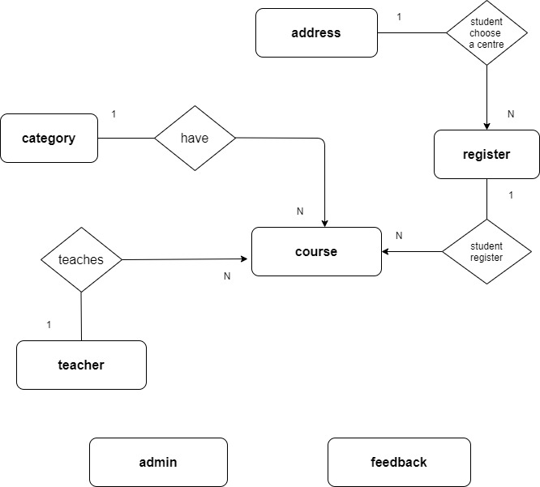
System Design – Entity Relation Diagram

Slide 14
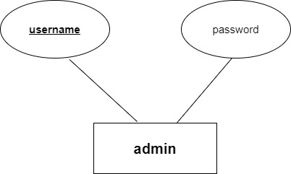
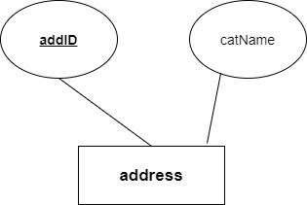
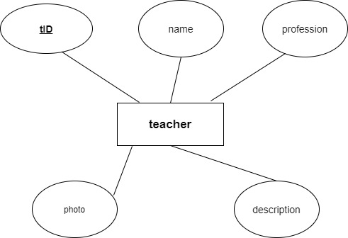
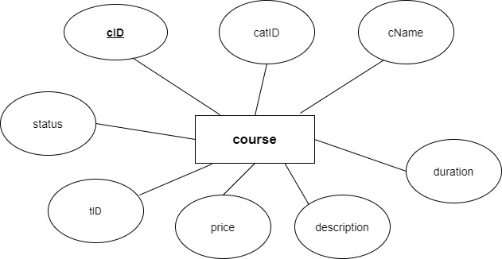
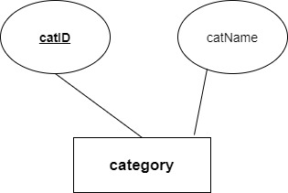
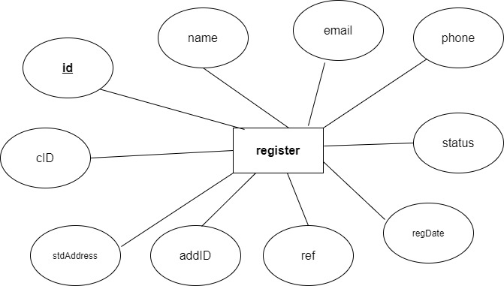
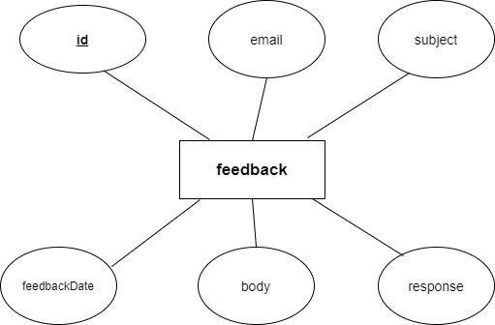
System Design – Entity Properties

Slide 15
Database Design
Table admin
Table address
Properties | Field Name | Type | Length | Note
Primary key | username | varchar | 50 | Admin username
 | password | varchar | 32 | Admin password
Properties | Field Name | Type | Length | Note
Primary key Auto-Increment | addID | int | 2 | Address ID
 | address | varchar | 500 | Address
Table category
Properties | Field Name | Type | Length | Note
Primary key Auto-Increment | catID | int | 2 | Category ID
 | catName | varchar | 100 | Category Name

Slide 16
Database Design
Table feedback
Table teacher
Properties | Field Name | Type | Length | Note
Primary key Auto-Increment | id | int | 3 | Message ID
 | feedbackDate | date |  | Date sent
 | email | varchar | 250 | Student/Guest Email
 | subject | varchar | 250 | Message subject
 | body | longtext |  | Message body
 | response | bit | 1 | Response status
Properties | Field Name | Type | Length | Note
Primary key Auto-Increment | tID | int | 2 | Faculty ID
 | name | varchar | 100 | Faculty name
 | profession | varchar | 250 | Faculty best field
 | photo | varchar | 500 | Image file name
 | description | longtext |  | Faculty information

Slide 17
Database Design
Properties | Name | Type | Length | Note
Primary key Auto-Increment | id | int | 2 | Register ID
 | name | varchar | 150 | Registrar name
 | email | varchar | 250 | Registrar email address
 | phone | int | 11 | Registration phone number
Foreign Key | cID | int | 2 | Reference to course
 | stdAddress | varchar | 450 | Student home address
Foreign Key | addID | int | 2 | Reference to address
 | ref | varchar | 50 | How does student know about the centre
 | regDate | date |  | Date in which student registered
 | date | date |  | Date Scheduled
Table course
Properties | Name | Type | Length | Note
Primary key Auto-Increment | cID | int | 2 | Course ID
Foreign Key | catID | int | 2 | Reference to category
 | cName | varchar | 250 | Course name
Foreign Key | tID | int | 2 | Reference to teacher
 | price | int | 7 | Course fee
 | description | longtext |  | Course description
 | duration | int | 2 | Course duration
 | status | bit | 1 | Visibility
Table register

Slide 18
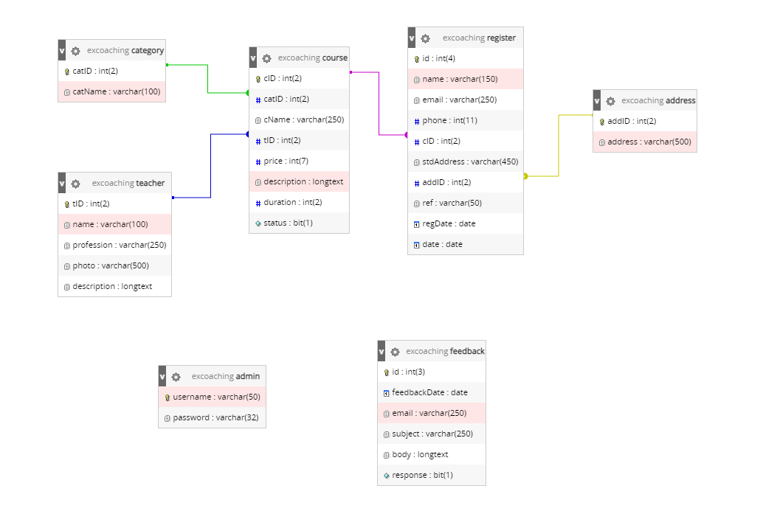
Table Relationships

Slide 19
Sitemap
For Guest
For Admin
Trang chủ
Quản lý danh mục
Trả lời phản hồi
Đổi mật khẩu tài khoản quản trị
Đăng nhập admin
Quản lý khóa học
Đặt lịch hẹn cho học viên
Quản lý giảng viên
Trang chủ
Xem thông tin và đăng ký khóa học
Tìm kiếm khóa học
Xem thông tin giảng viên
Gửi phản hồi
Giới thiệu về trung tâm

Slide 20
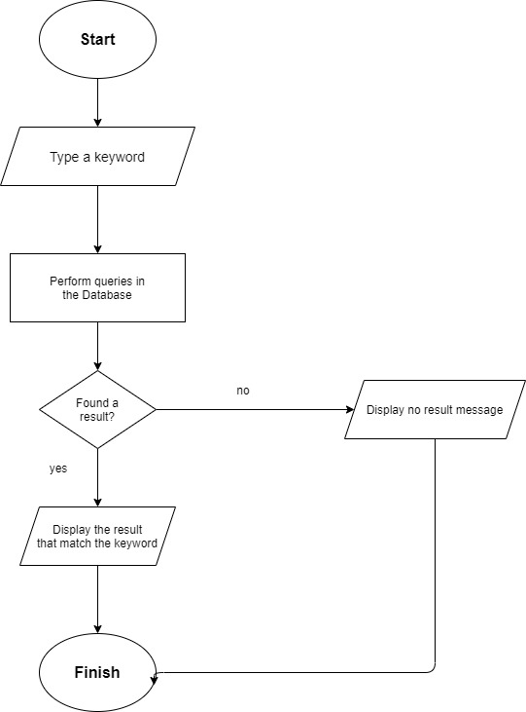
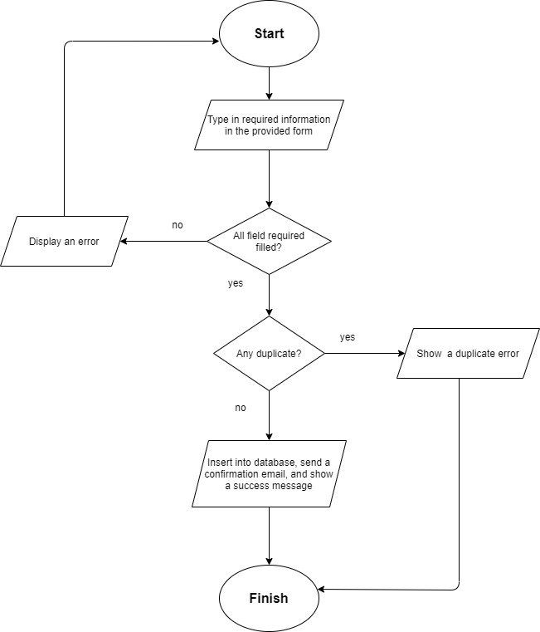
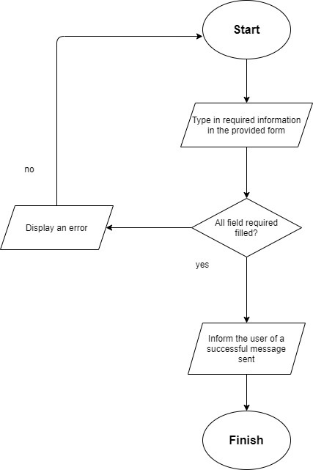
System Functions
Search a course
Student register a course
Send a message to the centre

Slide 21
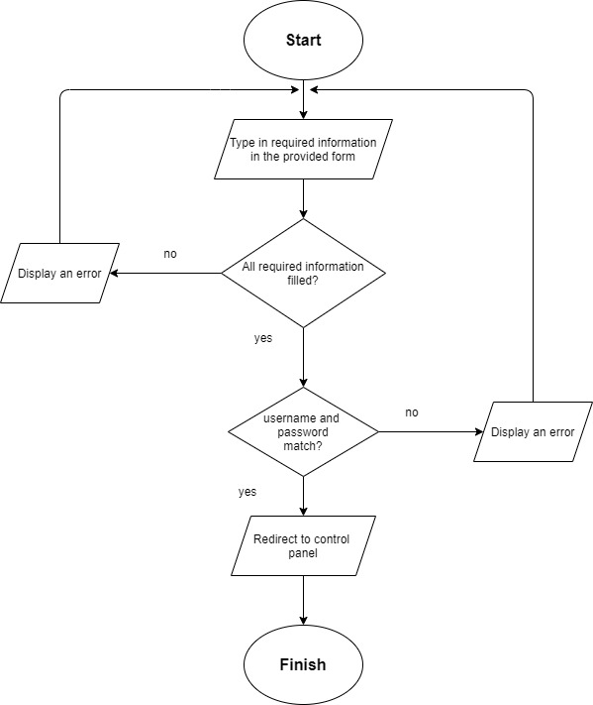
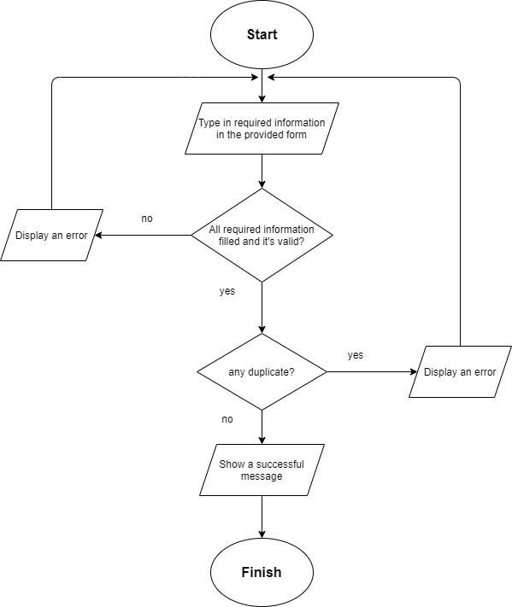
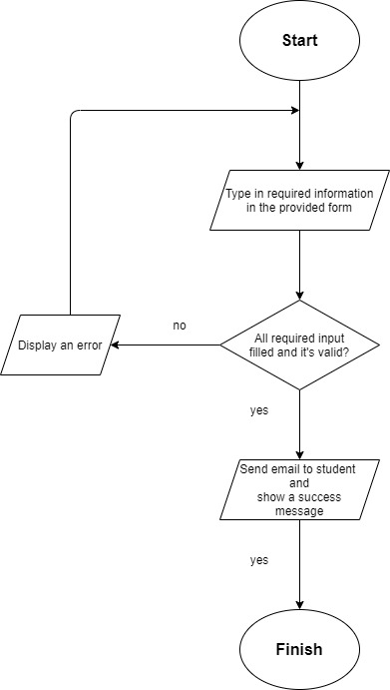
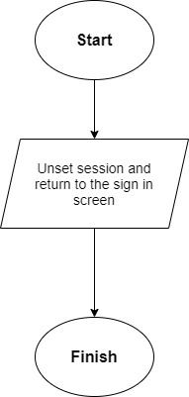
System Functions
Admin sign in
Add a course
Reply message
Admin sign out

Slide 22

Thank you
C2005L – Nhóm 1

